Slide 1
A Project on Smart Hand Sanitizer Dispenser

Slide 2
Submitted To : Mr. Ovishake Sen Lecturer Department of CSE Southeast University

Slide 3
Submitted By :
Md. Arshee Aman Chowdury Onik
ID : 2017000000227
Md. Zubair Salaken Tamim
ID : 2017000000205
Md. Abu Sufian Rahad
ID : 2017000000214

Slide 4
Introduction
Smart Hand Sanitizer Dispenser
In this current scenario of global outbreak for COVID-19, it is advised by WHO (world health organization) to maintain Healthy Hand Wash and Sanitation Habits, but the main problem is the way we do it, that is by physical touch to the bottle, which in short doesn’t serve our purpose, so in this tutorial, we will learn How To make a Arduino Based Soap or Hand Sanitizer Dispenser.

Slide 5

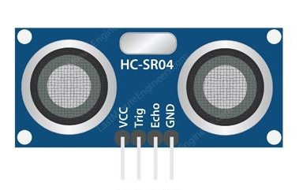
Components & Supplies
Arduino Uno.
Ultrasonic Sensor.

Slide 6
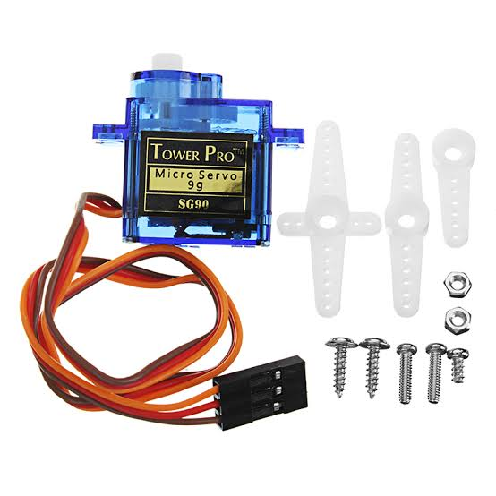
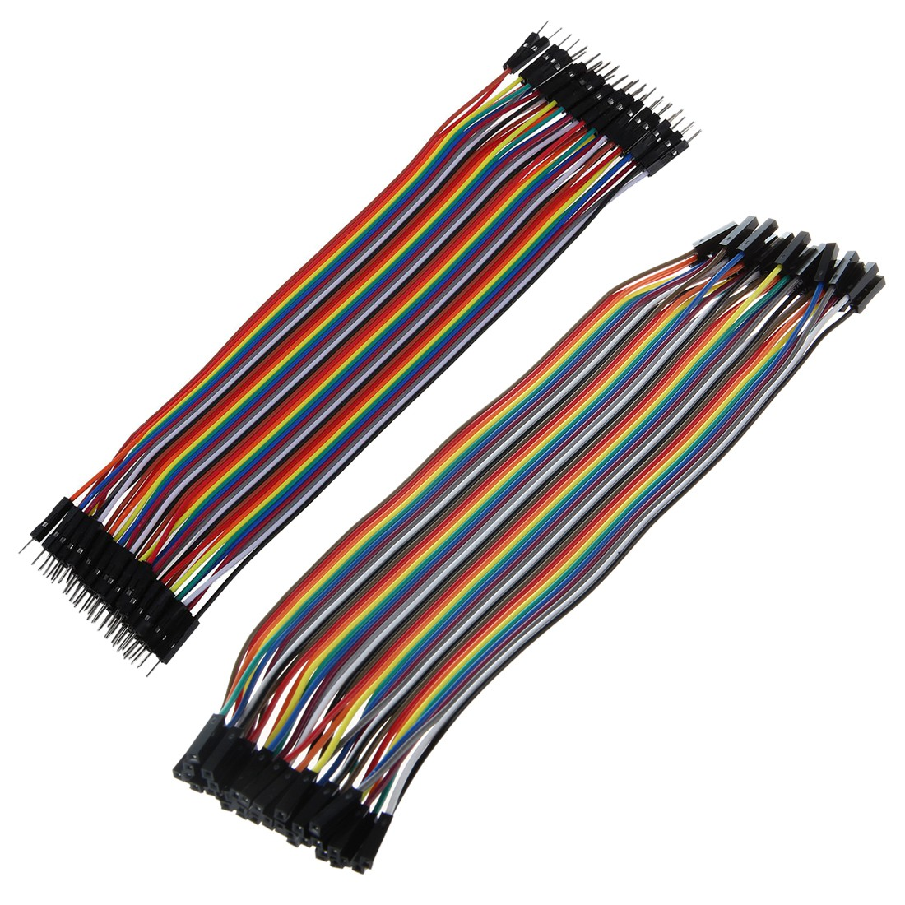
Servo Motor.
Jumper Wires.

Slide 7
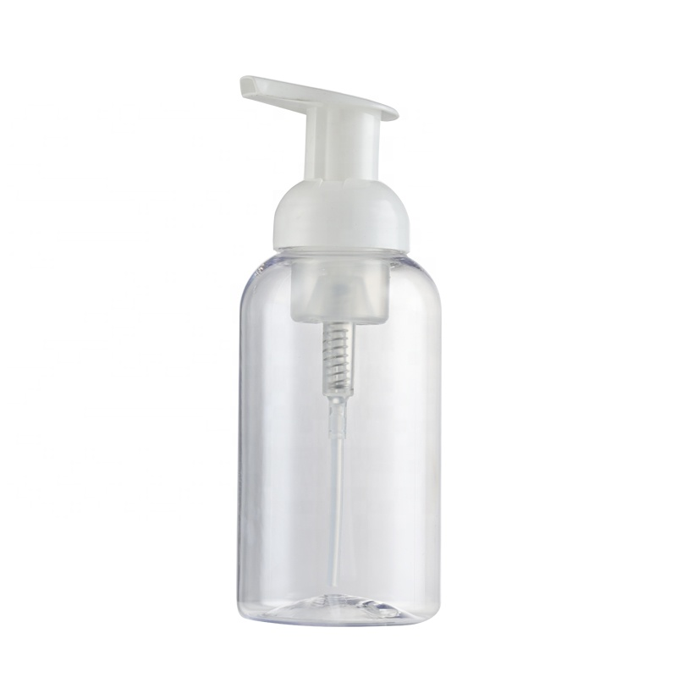
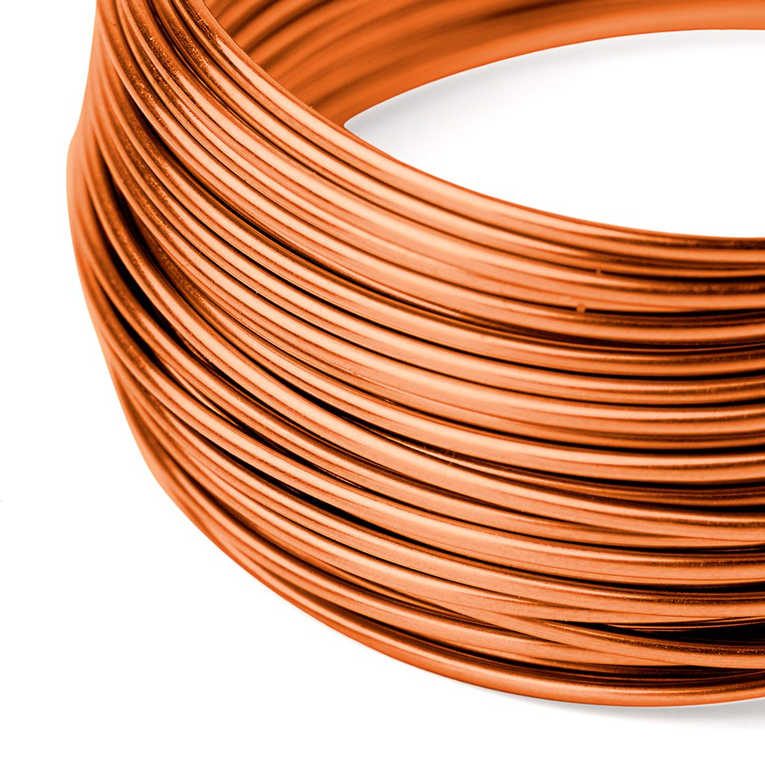
Push Type dispenser bottle.
0.8 mm copper wire.

Slide 8
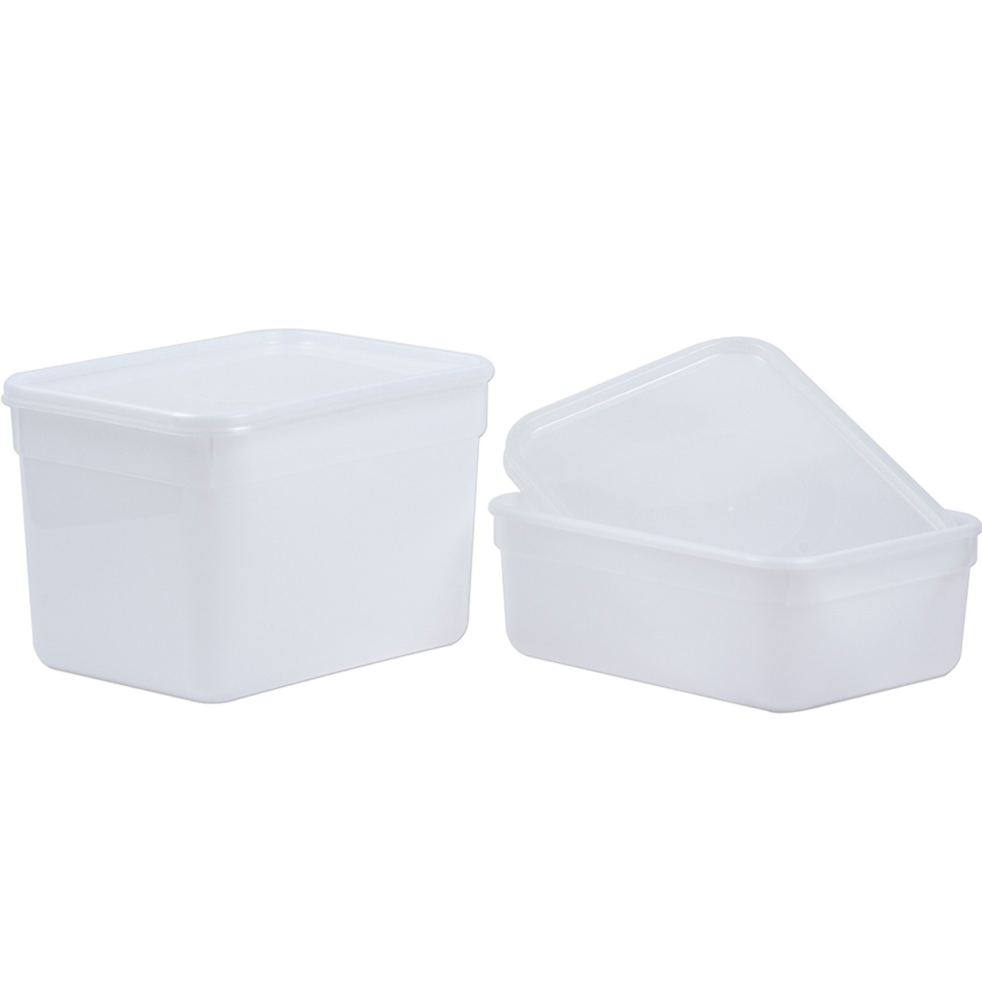
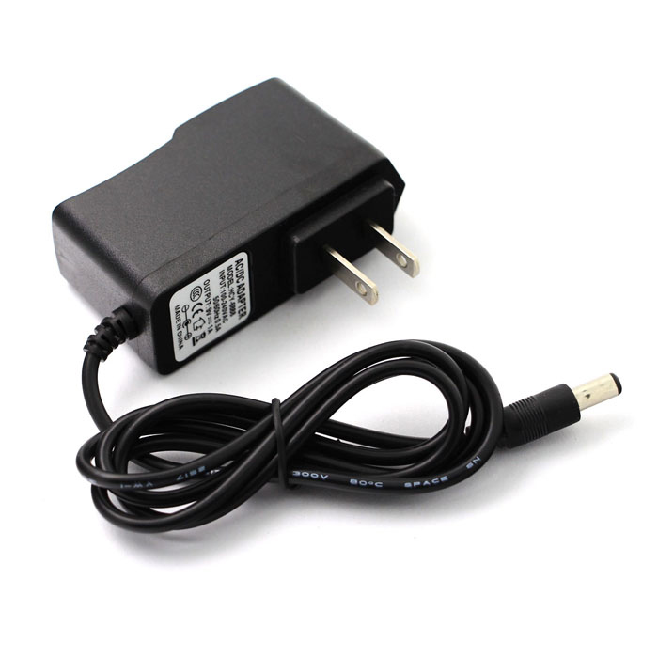
Plastic container.
Power supply.

Slide 9


Apps & Online Services
Arduino IDE 2.0.0
Tinkercad

Slide 10
Understand the Mechanics
Let's Understand the Mechanical Arrangement before we start making it. We will need a mechanism which will create a force to push the nozzle down and dispense the liquid, since we are using servo motor, that provides circular motion, it alone can’t create a downwards force, we will need some kind of mechanical arrangement to make it happen, we will use pulley mechanism to fix one end and convert the rotational force to push, we can do that using Copper Wire to create a downwards vector force for transmission, what it basically does is, it convert the circular force of Servo to a downwards acting force vector, to simulate push. but this all sounds complicated, so let’s execute this task bit by bit, following the further steps.

Slide 11
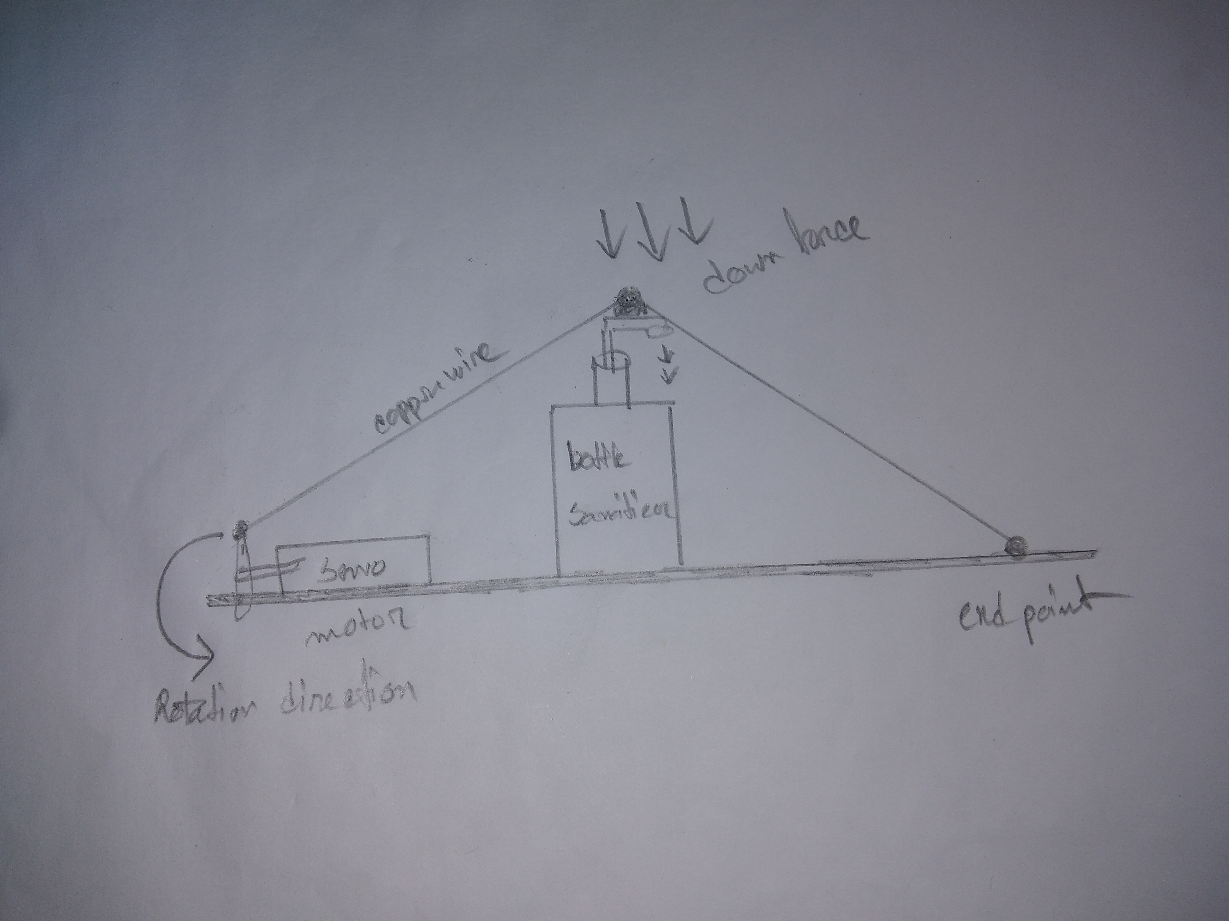
Sample design

Slide 12
Connections
Connections for this build is very simple !
Sensor to Arduino :
Trigger to D8 ; Echo to D9
Vcc to Vcc ; Gnd to Gnd
Servo to Arduino :
Signal to D7 ; Vcc to Vcc ; Gnd to Gnd
Tinkercad Project Link :
https://www.tinkercad.com/things/8CNIH9EHJGN-brilliant-bombul-curcan/editel?tenant=circuits

Slide 13
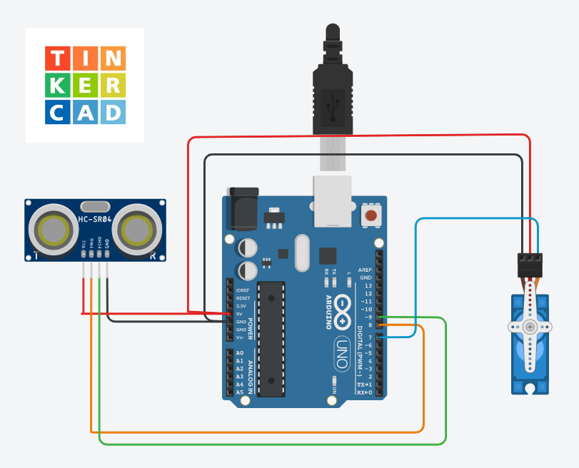

Slide 14
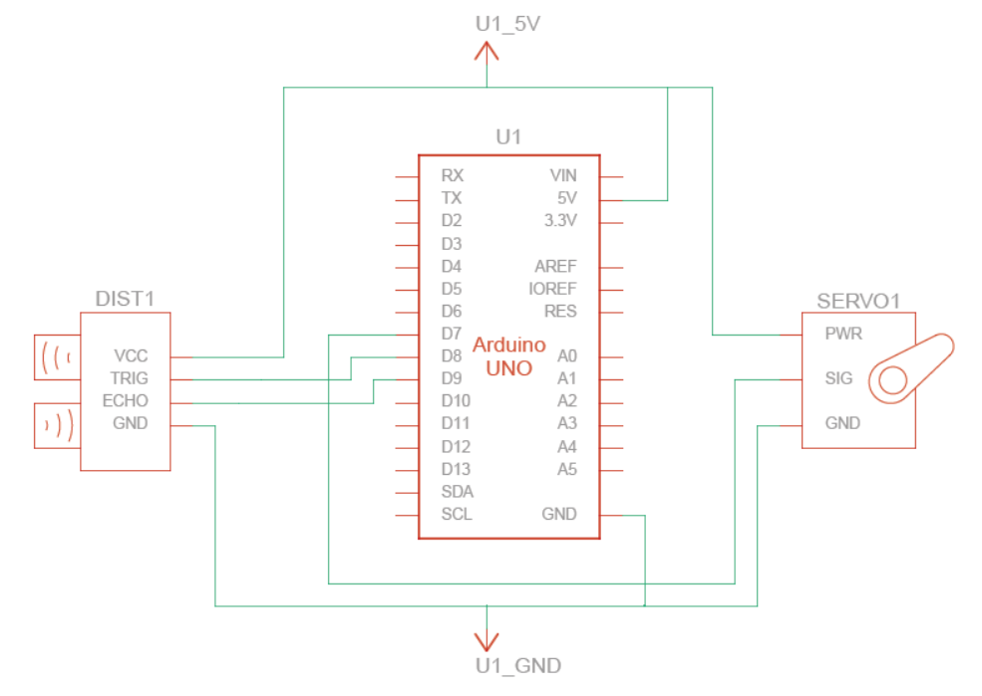
Circuit Diagram

Slide 15
Constructing the Machine
Attach Servo to Base
First step in mechanical arrangement is to attach Servo motor to one rigid surface inside the box, using hot glue.
Pass the Copper Wire Through Servo Arm
Pass the Copper Wire through Servo motor using the holes on Attachment Arm, pass at least through 2 holes to ensure proper tension is achieved using circular attachment arm would be better choice, since straight one can get caught inside enclosure.

Slide 16
Add Piece of Hot Glue Stick With Hole in Middle
Cut about 2 cm long piece of Hot Glue Stick and make a hole in middle, pass the copper wire through the piece of hot glue stick, which will indeed help to increase the surface area at contact point.
End Screw
Attach the second end of wire to another rigid surface (opposite face of servo motor), using a Self Threading Screw or a nail here would be a vise choice since it will allow us to adjust the tension or to remove the bottle for refill.

Slide 17
Complete the Enclosure
Once our project seems to be working, it's time to complete the enclosureFollow the steps to complete it:
Measure the Dimensions for Ultrasonic Sensor and holes for Bottle.Make a slot for Copper wire with extra room for Moment.Mark all cutting holes.Use Sharp Blade or Drill to plot the holes.Fix everything with the help of hot glue.
Upload the Code In theory our idea sounds perfect, let’s code this Arduino and test our idea in real world.The code is very simple to understand, we used the servo library, and defined basic setups and variables, the main code is such that it calculates the distance in centimeters and if the distance is less than 10 cm the servo motor performs a sweep motion to release the liquid.

Slide 18
Code
#include <Servo.h>
int trigpin = 8;
int echopin = 9;
int servopin = 7;
Servo servo;
float distance;
float duration;
void setup()
{
Serial.begin(9600);
servo.attach(servopin);

Slide 19
pinMode(trigpin, OUTPUT);
pinMode(echopin, INPUT);
servo.write(0);
delay(100);
servo.detach();
}
void measure()
{
digitalWrite(trigpin, LOW);
delay(5);
digitalWrite(trigpin, HIGH);
delayMicroseconds(10);

Slide 20
digitalWrite(trigpin, LOW);
duration = pulseIn(echopin, HIGH);
distance = (duration / 2) / 29.1;
Serial.print("Distance :");
Serial.print(distance);
Serial.println("cm");
delay(200);
}
void loop()
{
if ( distance < 20 )
{
servo.attach(servopin);

Slide 21
delay(1);
servo.write(0);
delay(3000);
servo.write(150);
delay(1000);
servo.detach();
}
}

Slide 22
Finally this project is done!
Thank You Everyone

